Slide 1


EXECUTIVE INFORMATION
SYSTEM

Slide 2
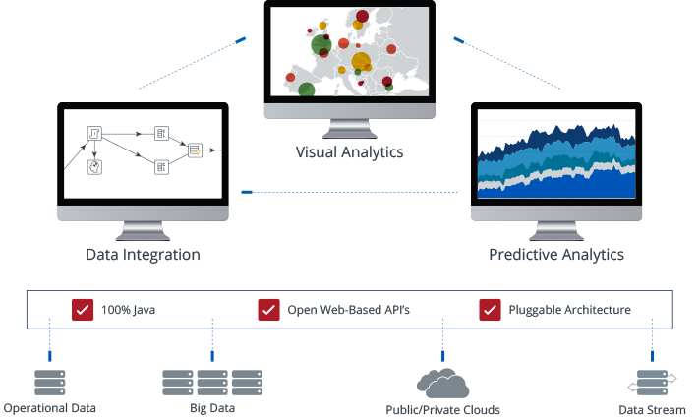
OVERVIEW
Dashboard & Statistic Analysis addresses the barriers that block your organization's ability to get value from all your data. Our platform simplifies preparing and blending any data and includes a spectrum of tools to easily analyze, visualize, explore, report and predict. Open, embeddable and extensible, Dashboard & Statistic Analysis is architected to ensure that each member of your team — from developers to business users — can easily translate data into value.

Slide 3
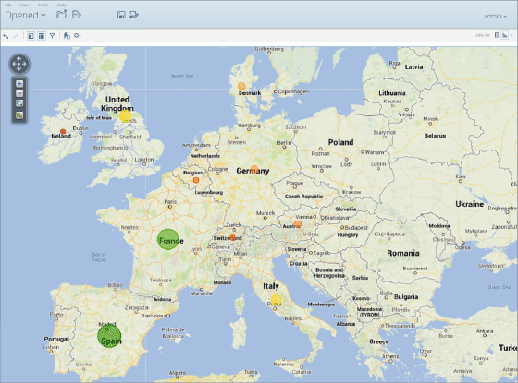
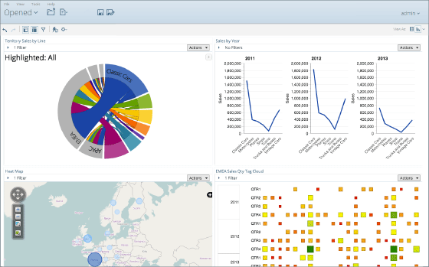
FEATURES
INTERACTIVE VISUAL ANALYSIS
Business users are self-reliant and can immediately access, analyze and visualize any data.
Interactive visual analysis with drill through, lasso filtering, zooming, and attribute highlighting for greater insight.
Out-of-the box library of interactive visualizations -- including geo-mapping, heat grids and scatter/bubble charts.
Specialized, visualization plug-ins deliver "the art of the possible" for advanced visualizations.
Extreme scale in-memory data caching for speed-of-thought analysis of large data volumes.
True mobile experience with support for native gestures and complete analytics capabilities, including content creation.
GRAPHICAL & RESPONSIVE DASHBOARDS
Interactive dashboards offer business users key performance indicators in a highly graphical visual interface to improve organizational performance.
Web-based drag and drop dashboard design including rich navigation, drilling and a library of filter controls.
Custom built dashboards uniquely tailored for your business.
Portal and mash-up integration seamlessly connects business analytics with other applications.
Learn more about embedded analytics or see how we turn customer mock-ups into customized dashboards in our dashboard gallery. True mobile experience with support for native gestures and complete analytics capabilities, including content creation.
Simple Statistics Analysis Module

Slide 4
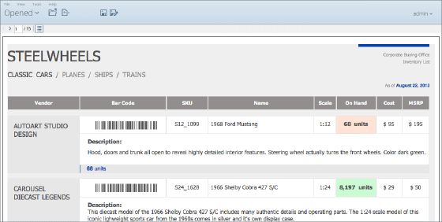
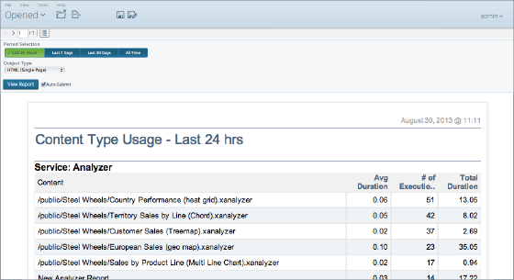
FEATURES
COMPREHENSIVE SOLUTIONS FOR REPORTING
Our reporting capabilities span the entire continuum from self-service interactive reporting to high volume, highly formatted enterprise reporting.
Intuitive web-based interactive reporting for business users.
Rich graphical enterprise report designer for power users.
Output in popular formats: HTML, Excel, CSV, PDF and RTF.
In-memory caching for fast results.
First to market direct reporting for NoSQL.
STREAMLINED MANAGEMENT AND ADMNISTRATION
Management and administration enabled with the ideal set of tools for efficient development, deployment and management in a streamlined user environment.
Analytics security, content permissions, versioning, locking and expiration.
World class reliability, backup and recovery.
Enterprise ready data integration with job restart and rollback.
Performance monitory and auditing with built in reporting.

Slide 5
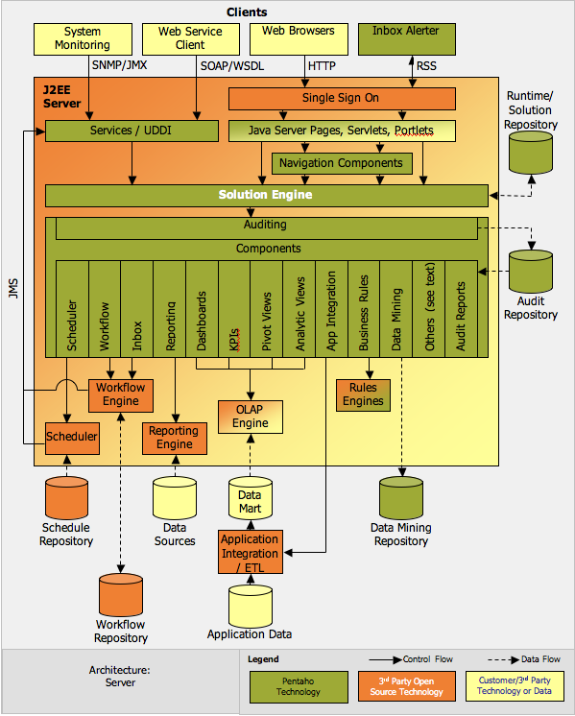
FEATURES
EASE OF USE WITH THE POWER TO INTEGRATE ALL DATA
Intuitive drag-and-drop data integration coupled with data agnostic connectivity spanning from flat files and RDBMS to Hadoop and beyond.
Graphical extract-transform-load (ETL) designer to simplify the creation of data pipelines
Rich library of pre-built components to access, prepare, and blend data from relational sources, big data stores, enterprise applications, and more
Powerful orchestration capabilities to coordinate and combine transformations, including notifications and alerts
Agile views for modeling and visualizing data on the fly during the data preparation process
Integrated enterprise scheduler for coordinating workflows and debugger for testing and tuning job execution
Business Intelligence Platform
Data Mining
SYSTEM ARCHITECTURE

Slide 6


